Slide 1
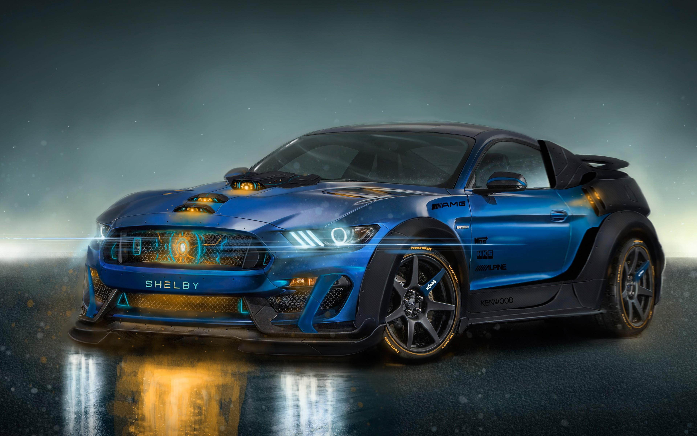
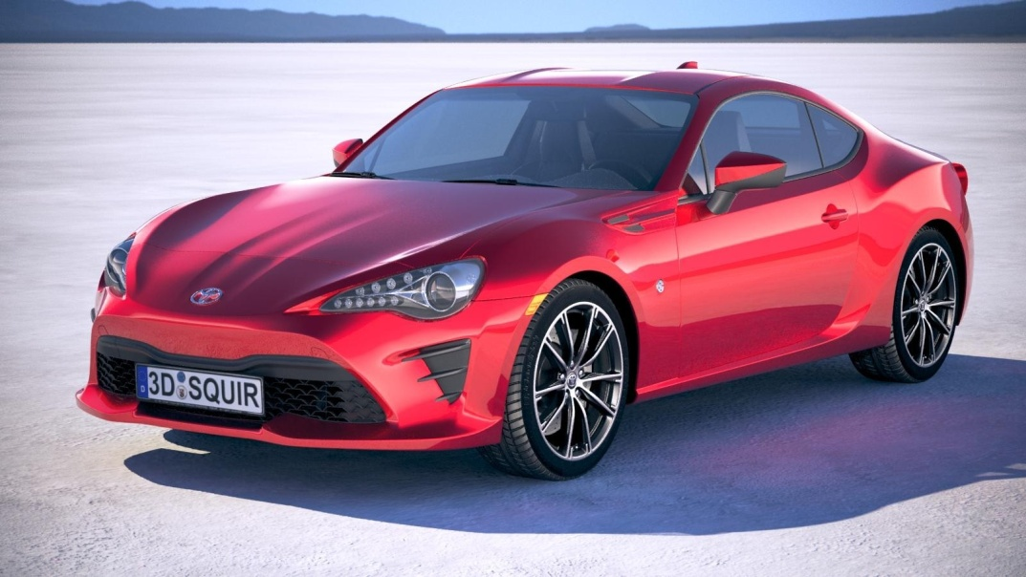
ONLINE CAR RENTAL SYSTEM

Slide 2
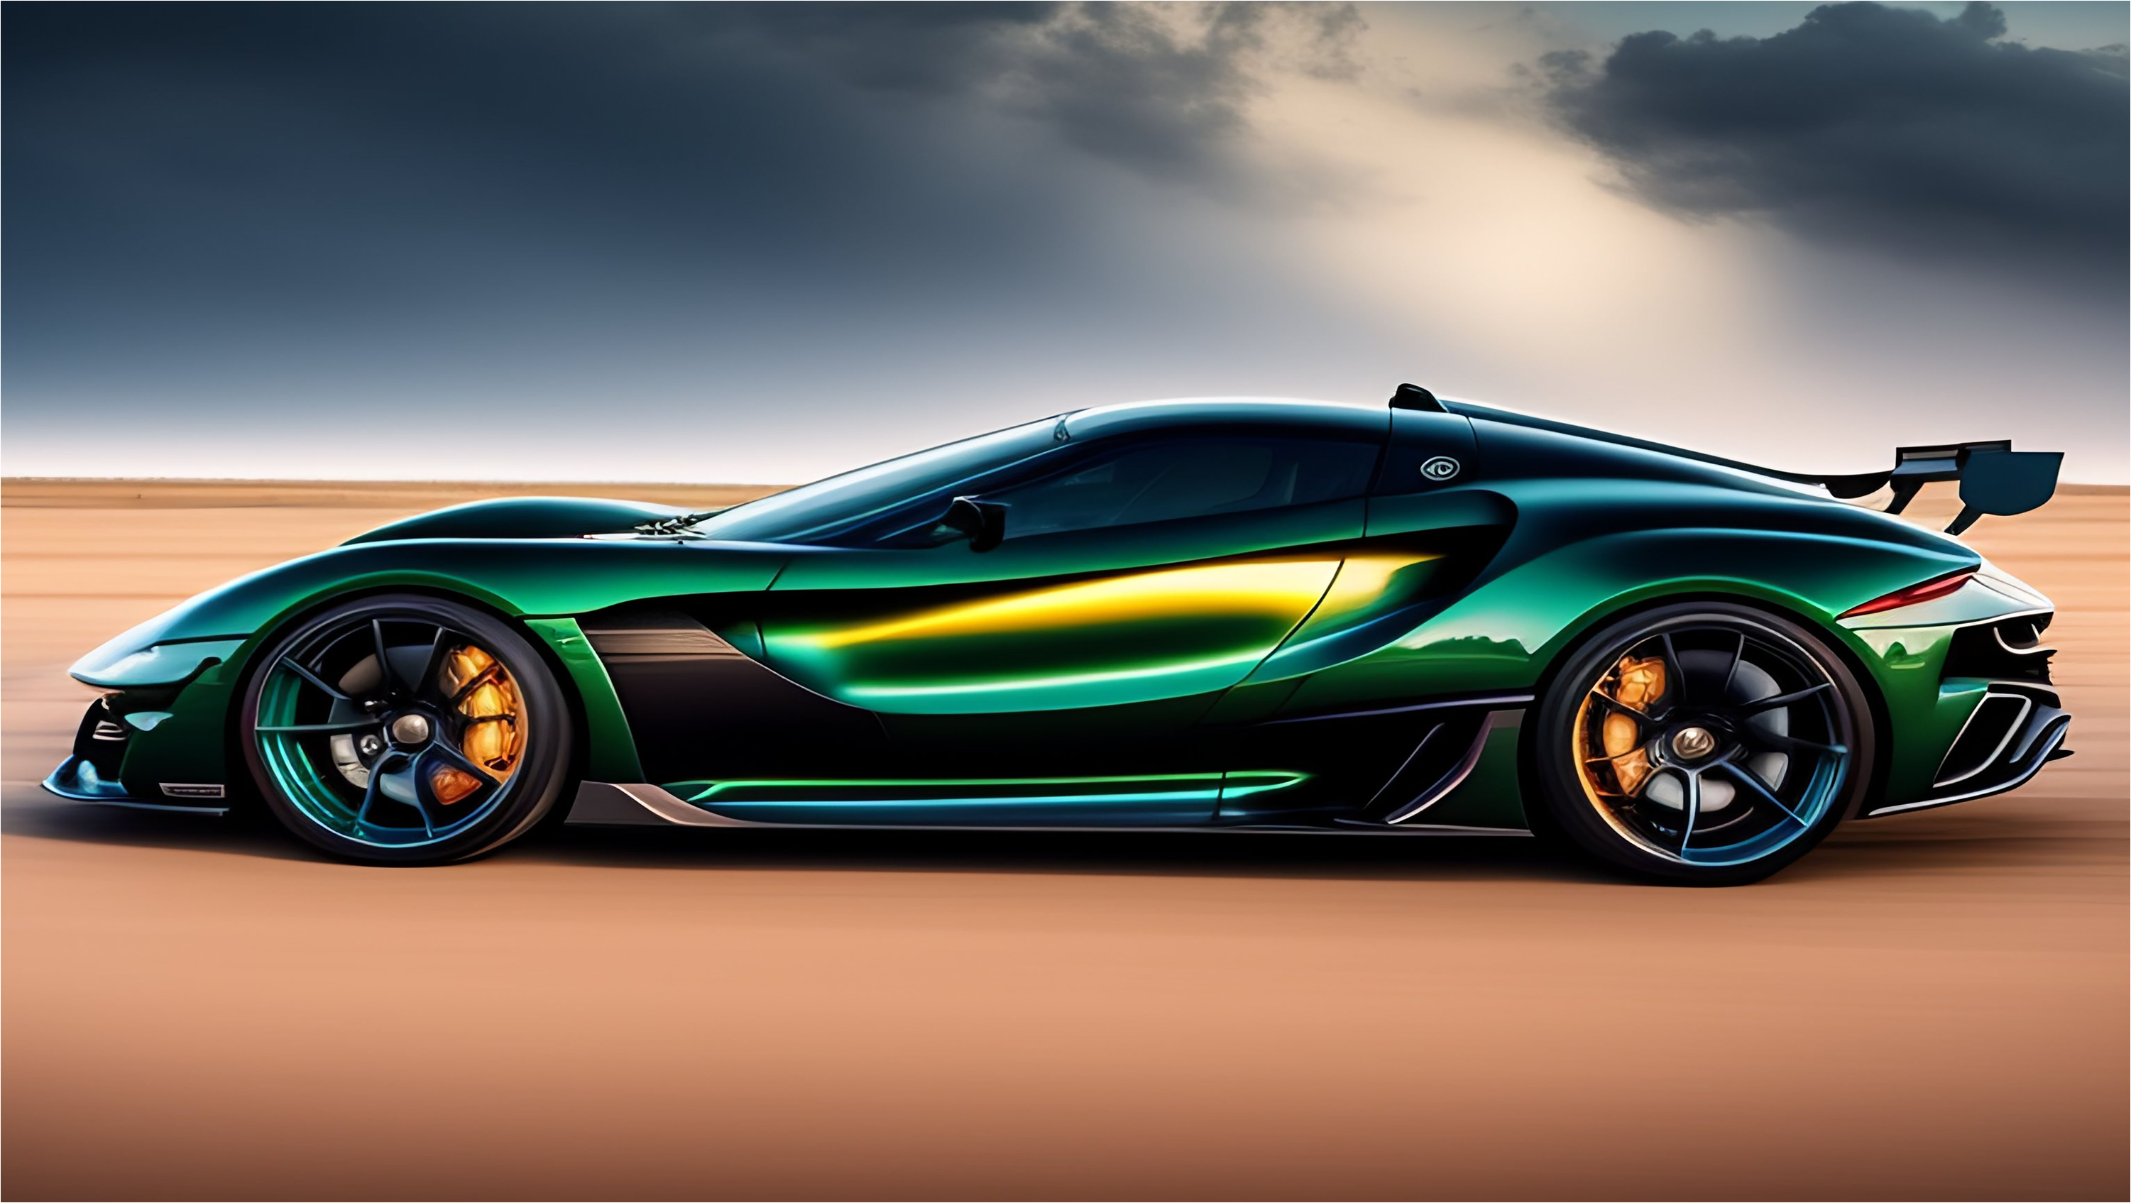
PRESENTED by
STUDENT DETAILS
Name:
Course Code:
Session:
2020 -2023
RU Roll No.:
20BS5852539
Department:
BCA
DSE-4P
AJAY KUMAR
This project is possible under the guidance of Mr SHIBLI AKHTAR

Slide 3

INTRODUCTION
SYSTEM REQUIRED
OVERVIEW
SCREENS
MODULES
6 DATABASE
7 CONCLUSION
8 FUTURE SCOPE
TABLE OF
CONTENT

Slide 4

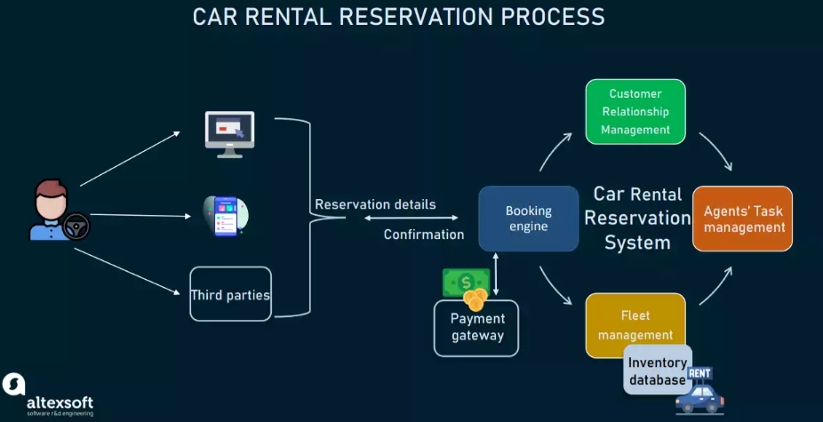
INTRODUCTION
It is an online system through which customers can view available cars, register, view profile and book car. Nowadays, most of the people prefer car for their trip. Because car journey to any trip with our family or friends gives happiness and makes us to feel comfortable.
Many advantages in car rental system rather than using own cars for their journey.

Slide 5
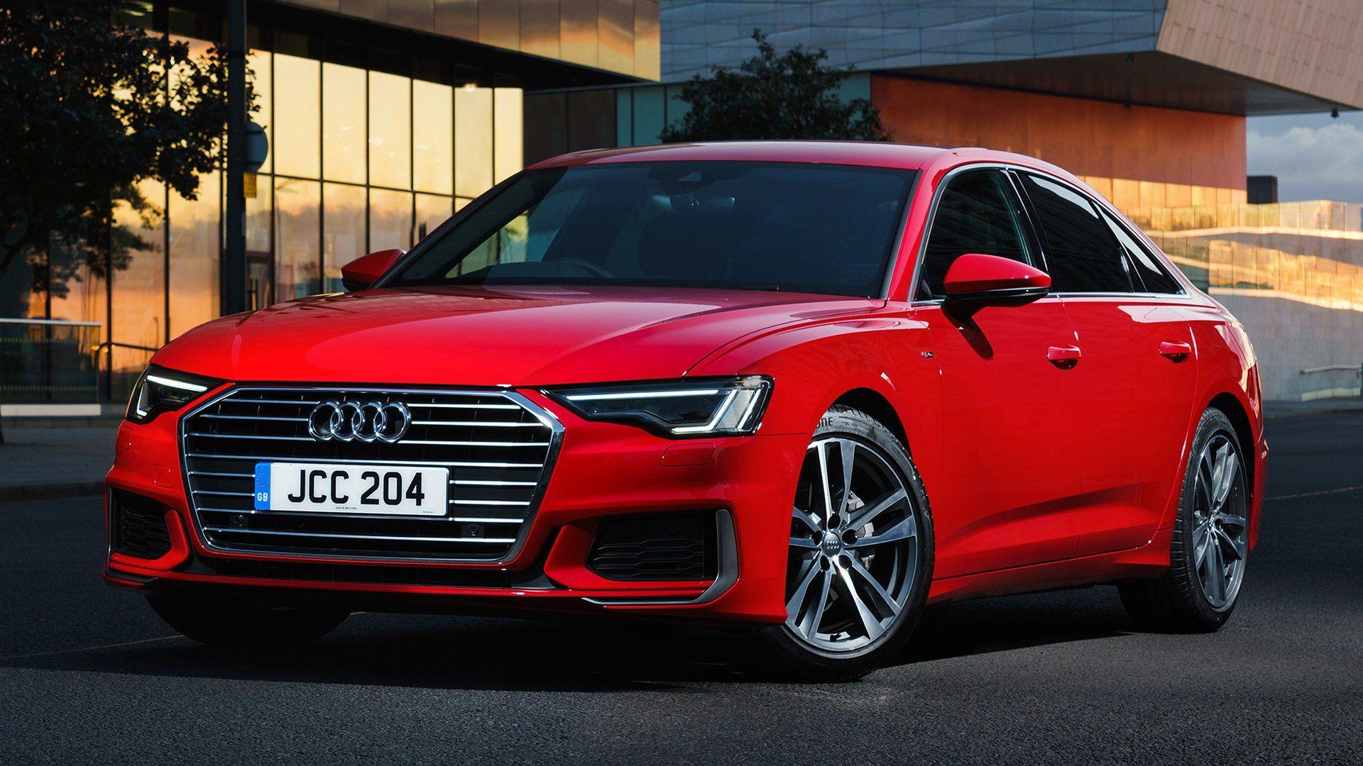











SOFTWARE
SYSTEM REQUIREMENTS
HARDWARE
PROCESSOR (INTEL i3)
Pentium (R) Dual
Windows 7 AND ABOVE
2GB
PHP,HTML,JAVASCRIPT
,CSS
Hard Disk:- 20GB
MY SQL
GOOGLE CHORME,
MOZILLA etc.

Slide 6
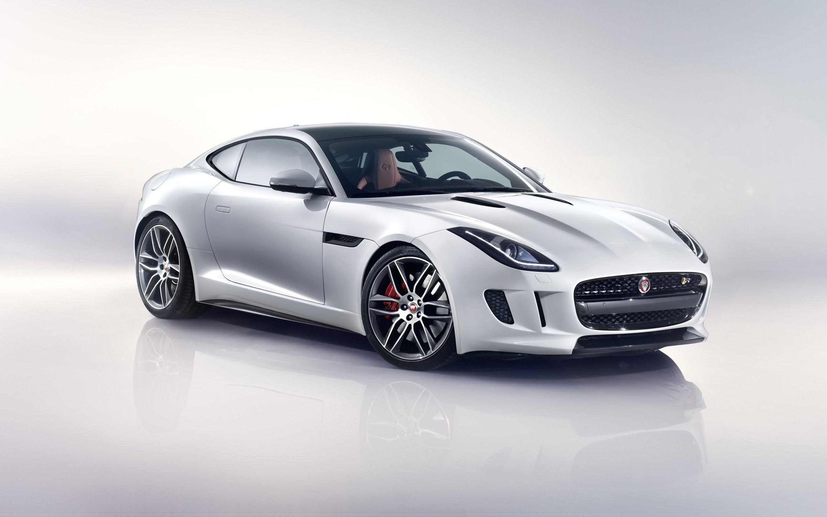







ENTER DETAILS
OVERVIEW
B00KED
PAYMENTS
USERS

Slide 7
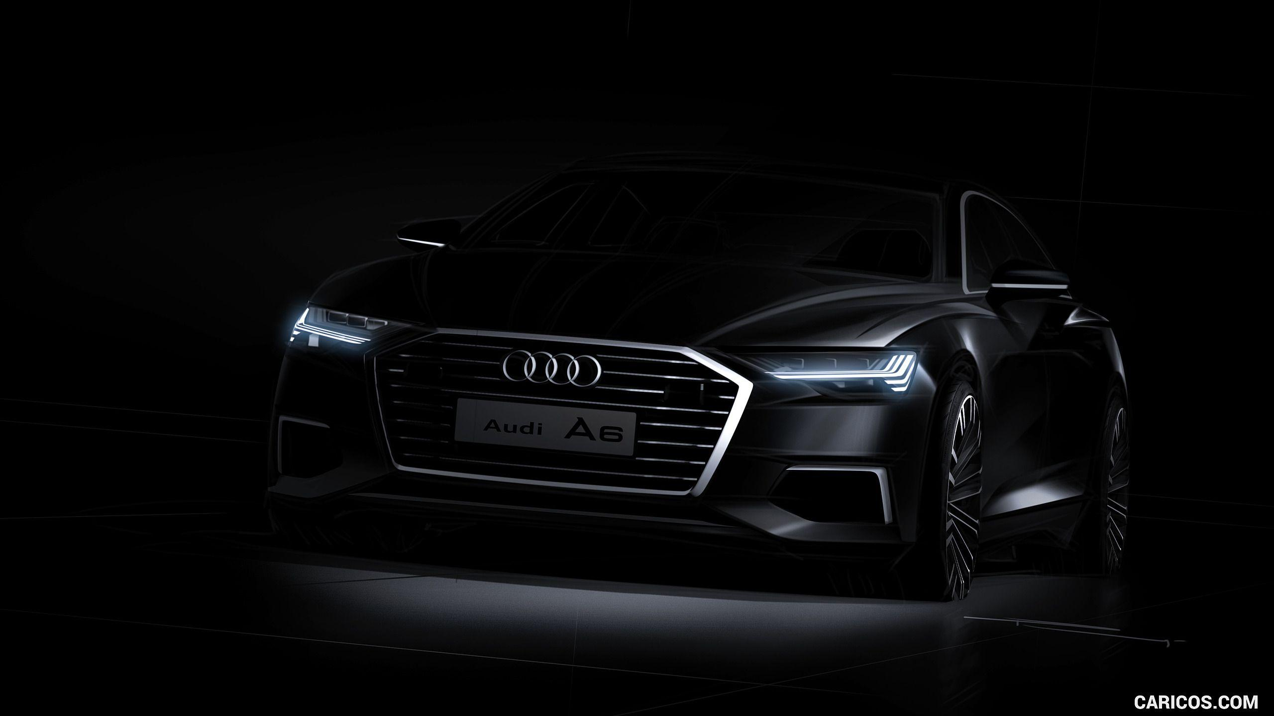

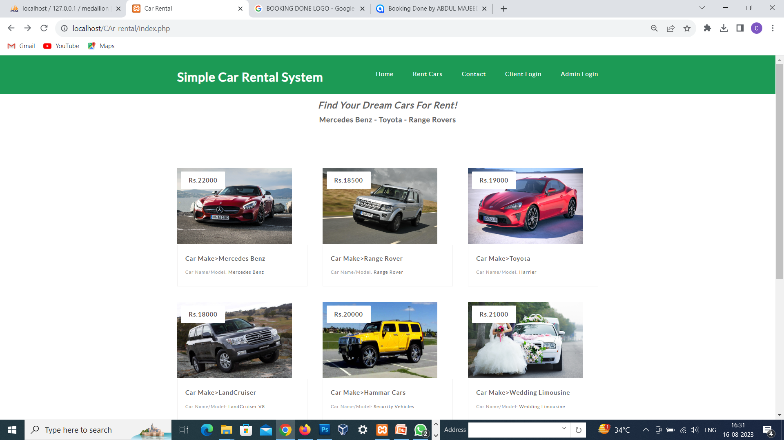
WEBSITE ENTER SCREEN

Slide 8
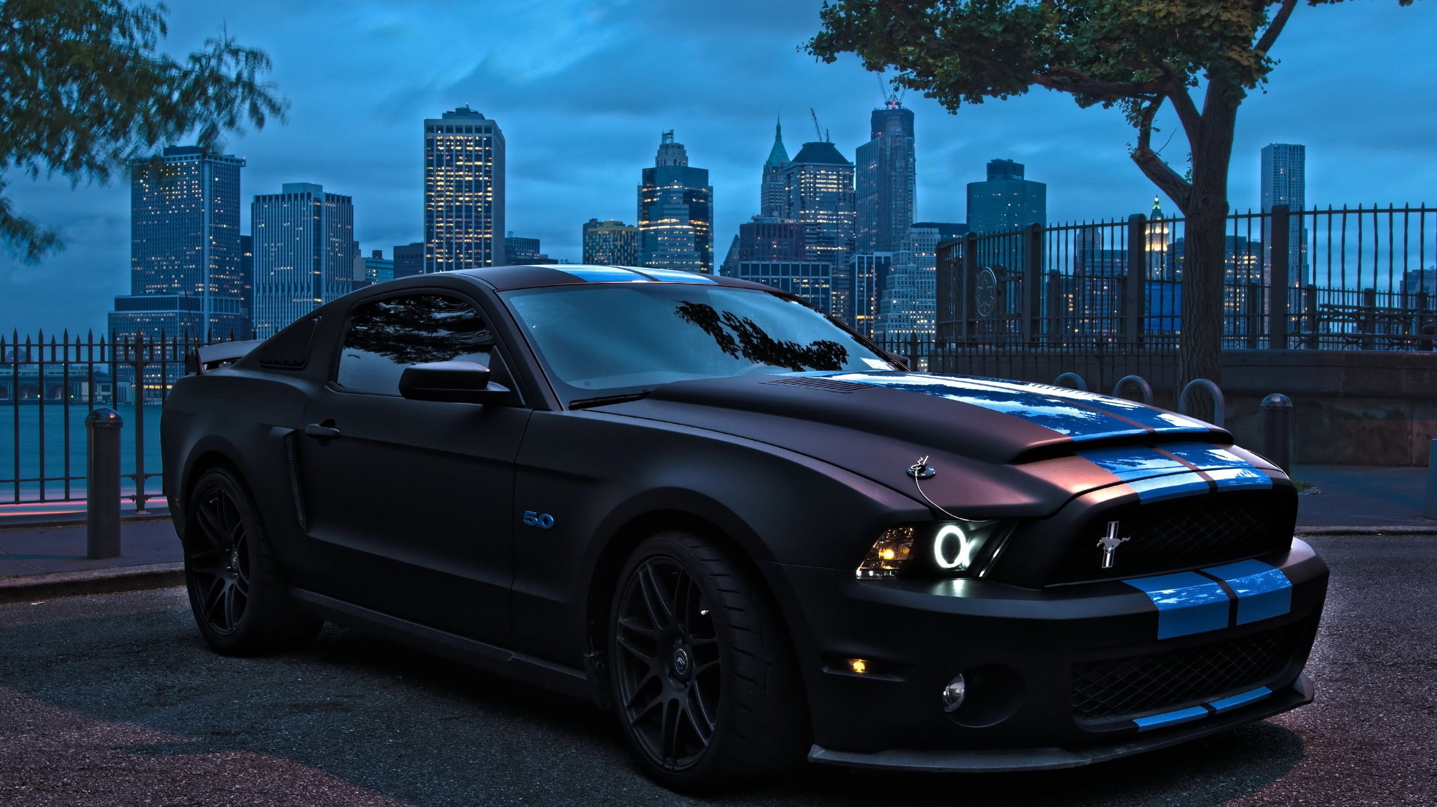
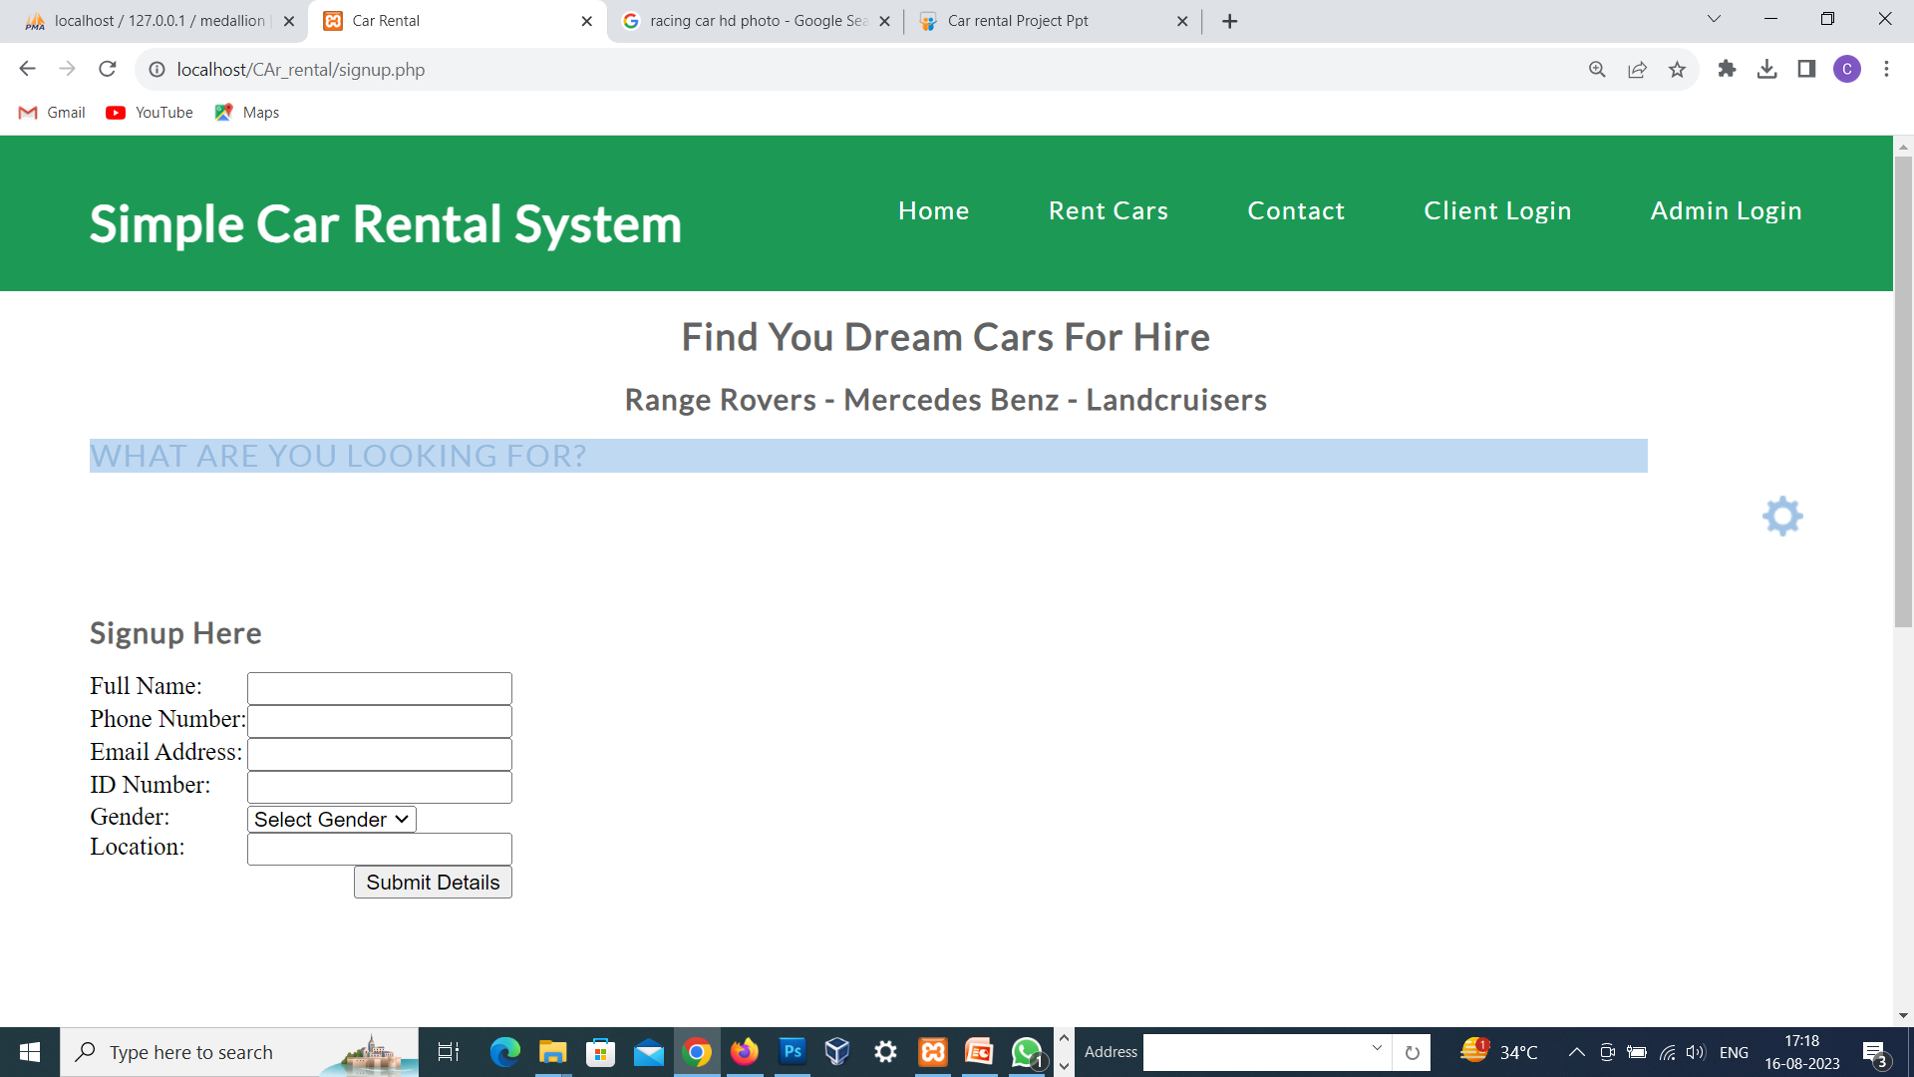
REGISTRATION SCREEN

Slide 9

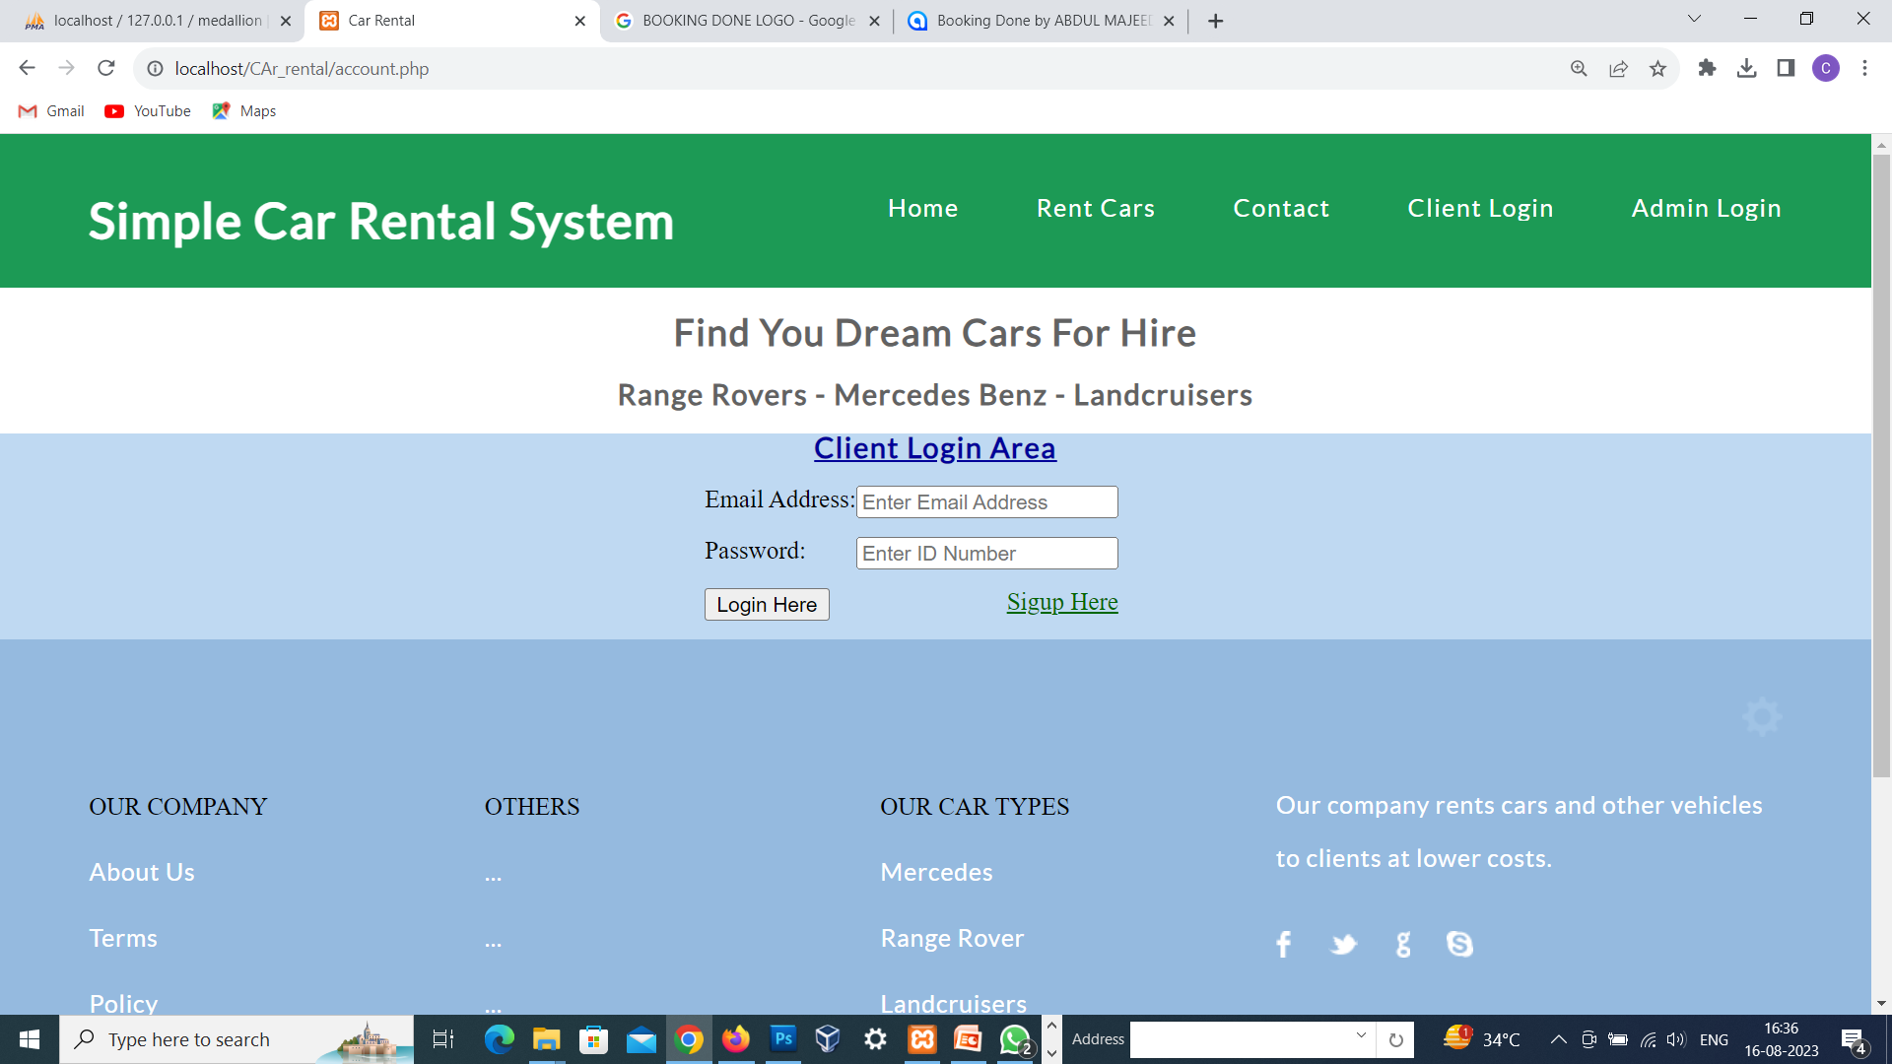

CLIENT LOGIN SCREEN

Slide 10

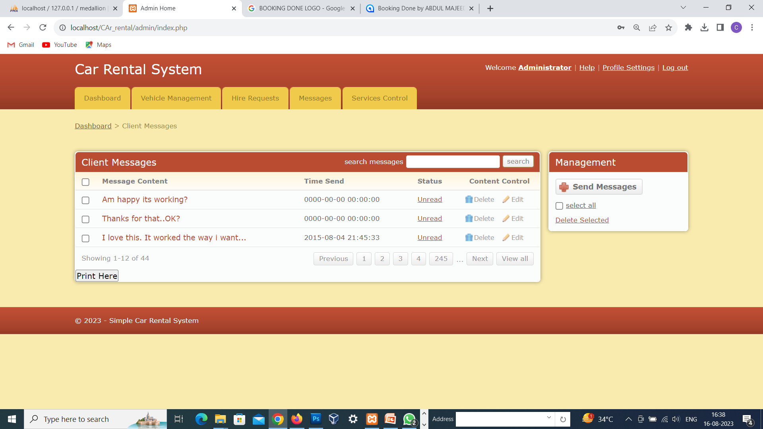
ADMIN MAIN SCREEN AREA

Slide 11
ADMIN MODULE
Admin can create vehicle brands
Manage Vehicle Brands(Edit, Delete)
Post Vehicle
Manage vehicle(Edit Delete)
Manage Booking(Admin can confirm and Cancel Booking)
Manage Testimonials (Active and Inactive)
Manage to Contact us Query
Admin Can the details of registered users
Admin can also update the page content
Admin can update the contact us details
Manage Subscribers.
Admin Dashboard(Admin can view the count of reg users, total booking, total subscribers, total queries, etc)
Change Password(admin can change own password)

Slide 12

USER MODULE
Car Booking
View Car booking history
Update His Her profile
Update his/her password
Logout

Slide 13
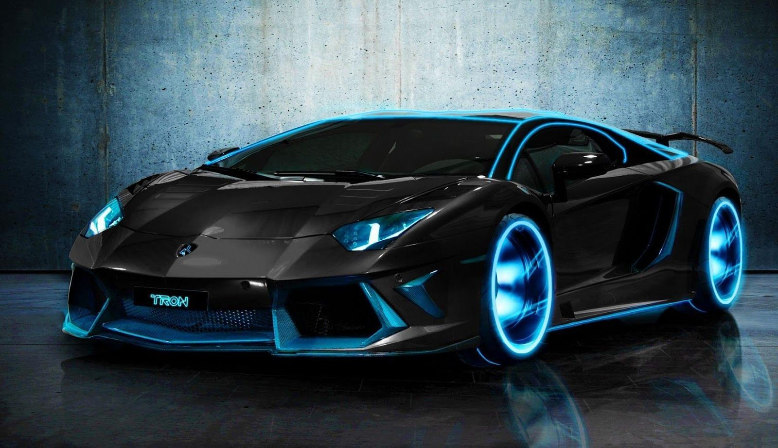
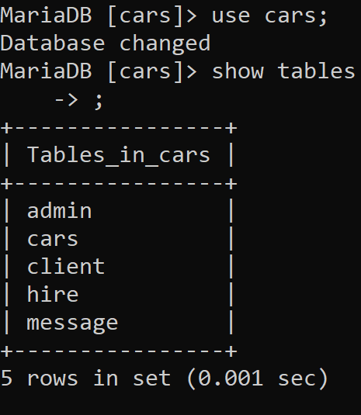
DATABASE
DATABASE NAME
DATABASE’S TABLE NAME

Slide 14

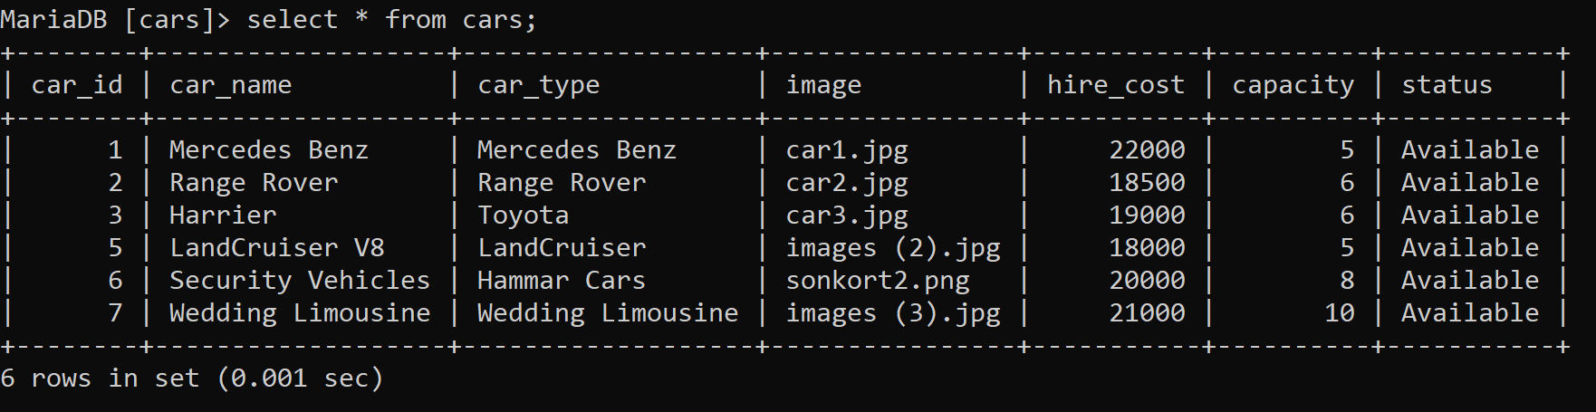
DATABASE
CARS BOOKING DETAILS

Slide 15
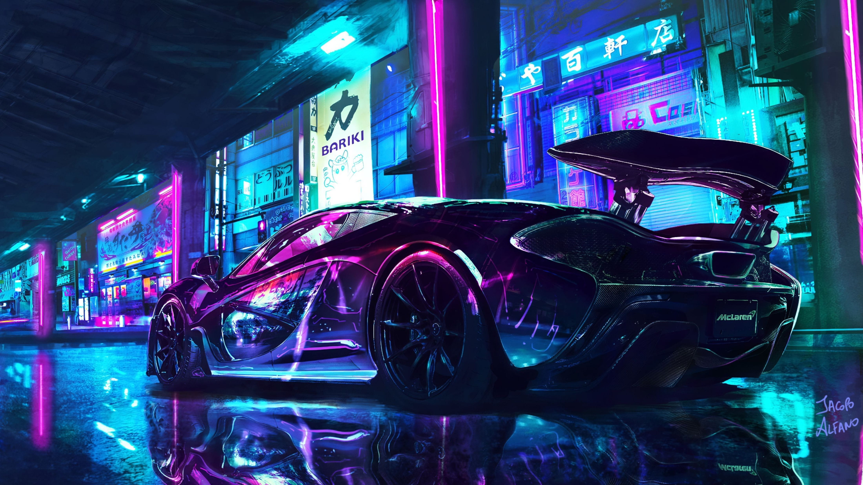


CONCLUSION
The solution was to provide car Rental with an user-friendly web application that would allow for customers to access and use on a wide range of devices: desktops, laptops, mobile devices, tablets.
The website is designed to stay up to date by giving administrators the ability to change/add/remove any featured vehicles on the site.
The website will verify and store any information the user may input when making a rental purchase request, This will appear in real time onto the software used by the employees.
This software provides an easy-to-use interface to allow for simple access to rental requests and Customer information

Slide 16

FUTURE SCOPE
Automation of the entire system improves the efficiency.
It provides a friendly graphical user interface which proves to be better when compared to the existing system.
It gives appropriate access to the authorized users depending on their permissions.
It effectively overcomes the delay in communications. Updating of information becomes so easier.
System security, data security and reliability are the striking features.
The System has adequate scope for modification in future if it is necessary

Slide 17



Thank You!

